Slide 1
Stock Market Prediction using NIFTY-50 Stock Data
Submitted By:
Zubayer Bin Rashid - 1782
Abdul Basit Karim Chy - 1788
Submitted To:
Faisal Ahmed
Assistant Professor
Premier University Chittagong

Slide 2


Purpose
Stock Market Prediction using NIFTY-50 Stock Data
1
2
3
Compare performance of different machine learning algorithms for predicting good stock and select the best
Identify patterns in NIFTY-50 stock data to inform investment decisions
Develop a model to predict better stock from NIFTY-50 stocks using historical data

Slide 3
Motivation
Help investors make more informed investment decisions and potentially increase their returns
Accurately predicting best stock that can help promote economic growth and stability
Applications:
Investment decision making: The model developed in this project can be used by investors to make more informed investment decisions by providing them with accurate predictions of future stock prices
Government and central bank: Governments and central banks can use the model to better understand the stock market and make more informed economic policy decisions
Algorithmic trading: The model can be integrated into algorithmic trading systems to make automated buy and sell decisions based on predicted stock prices

Slide 4
About Dataset

Slide 5
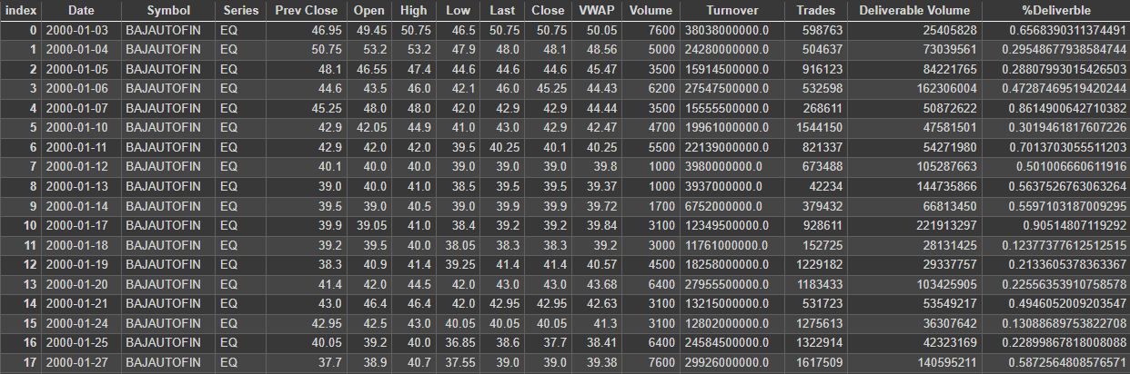
Dataset Information
Table 1: Glimpse of the dataset

Slide 6

Dataset Information Continued
Series -> type of security
Prev Close -> Previous day's close price
Open -> Open price of day
High -> Highest price in day
Low -> Lowest price in day
Last -> Last traded price in day
Close -> Close price of day
VWAP -> Volume Weighted Average Price
Volume -> No of shares traded
Turnover -> Total no of shares traded
Trades -> Total transactions
Deliverable Volume -> Stocks traded and Settled
%Deliverble -> Shares available for trading
Dataset collected from: Kaggle (Author: Vopani)

Slide 7
Data Preprocessing
Sample metadata:
After applying Label Binarizer:
No | Symbol
01 | AXISBANK
02 | ZEEL
03 | TITAN
04 | TATA
No | AXISBANK | ZEEL | TITAN | TATA
01 | 1 | 0 | 0 | 0
02 | 0 | 1 | 0 | 0
03 | 0 | 0 | 1 | 0
04 | 0 | 0 | 0 | 1
Table-2: sample metadata
Table-3: effect of Label Binarizer

Slide 8
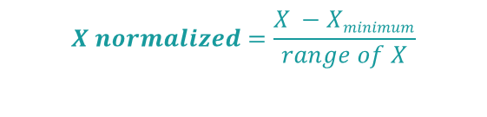
Data Preprocessing Continued
Before Normalization:
After Normalization:
No | X
01 | 46.95
02 | 50.75
03 | 48.1
04 | 44.6
No | X
01 | 0.382
02 | 1
03 | 0.569
04 | 0
Table-4: Sample dataset
Table-5: Normalized dataset
$$X normalized=\frac{X −Xminimum}{range of X}$$
∴ Range of X: X_{max} - X_{min}

Slide 9
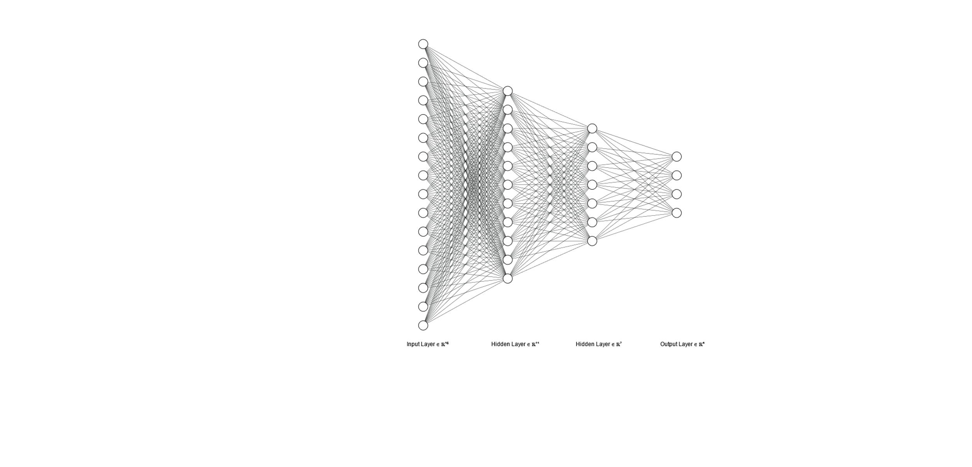
Neural Network Model
We aim to predict good stocks using historical stock data. The input dataset includes 16 different attributes, such as Open, High, Low, Close, and Volume, of NIFTY-50 stock data. In this multiclass problem the output we are trying to predict have 4 different attributes which includes the company name that an investor should invest in.
Figure-1: visualization of our model

Slide 10
Thank you
"The stock market is filled with individuals who know the price of everything,
but the value of nothing." - Philip Fisher

